Slide 1
#8.1
Male and female are disjoint categories:
∀x Male(x) ⇔ ¬Female(x)
A sibling is another child of one’s parent:
∀x,y Sibling(x, y) ⇔ x≠y ^ ∃p Parent(p,x) ^ Parent(p, y)

Slide 2
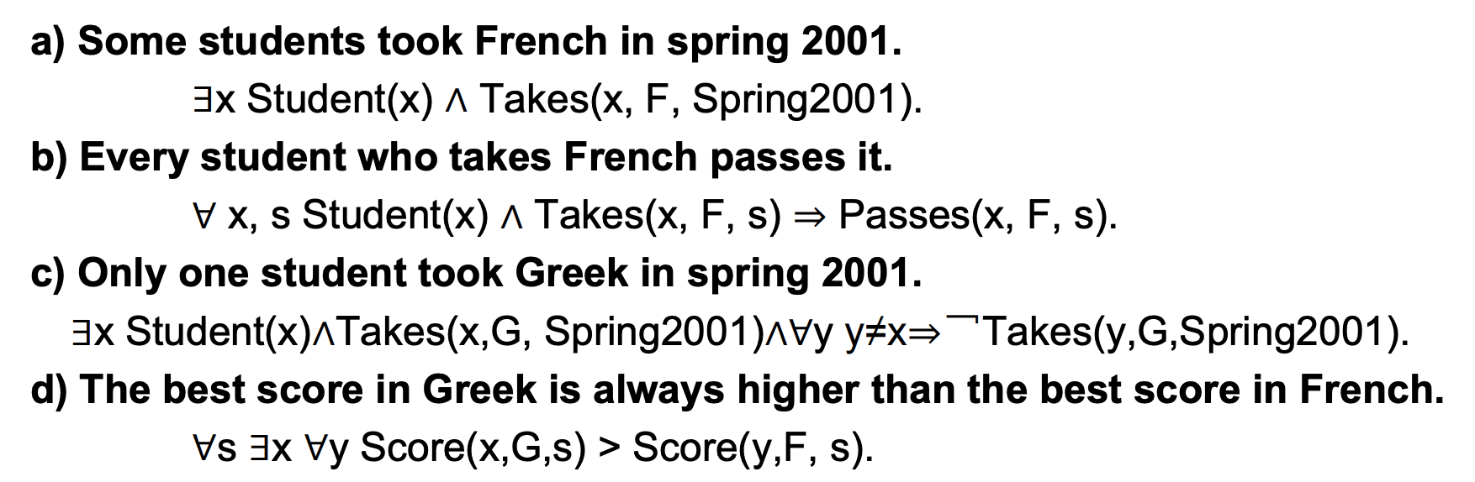
#8.2

Slide 3
#8.3
AsHighAs(Kilimanjaro, Everest)
AsHighAs(Kilimajaro, Everest) and AsHighAs(BenNevis, Everest)
It’s fine as long as you don’t reuse an existing constant

Slide 4
#8.4
x = A, y = B, z = B
Doesn’t exist
X = John, y = John
Doesn’t exist

Slide 5
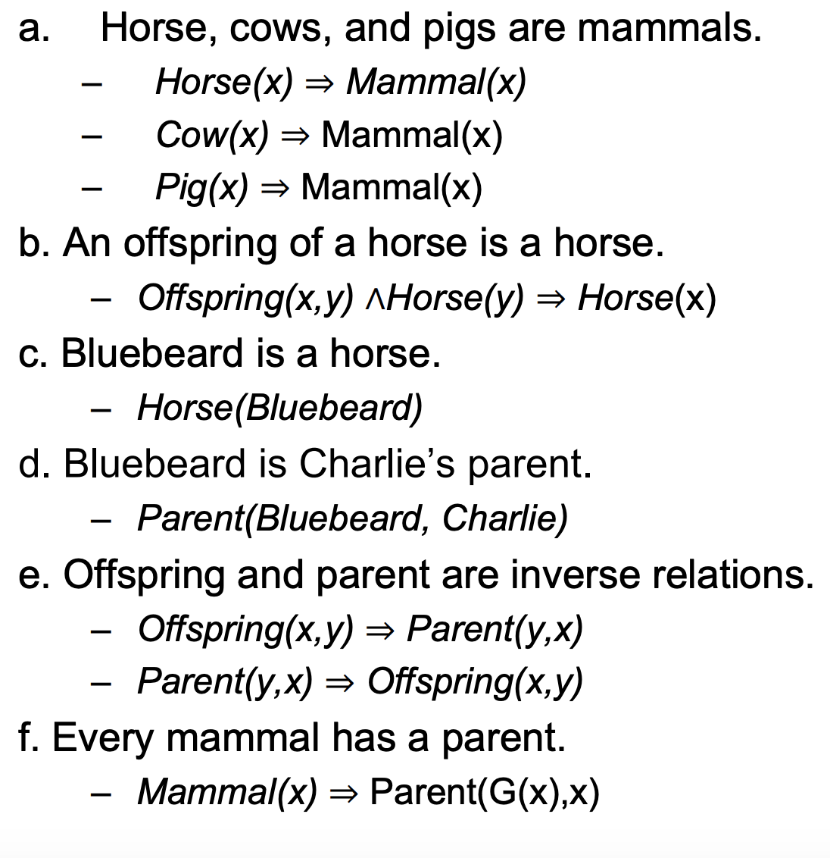
#8.5

Slide 6
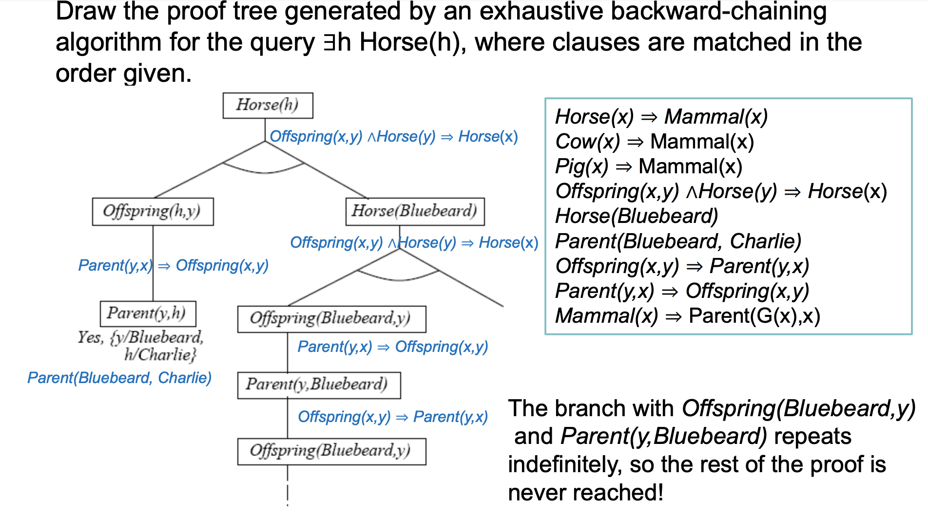
#8.5

Slide 7
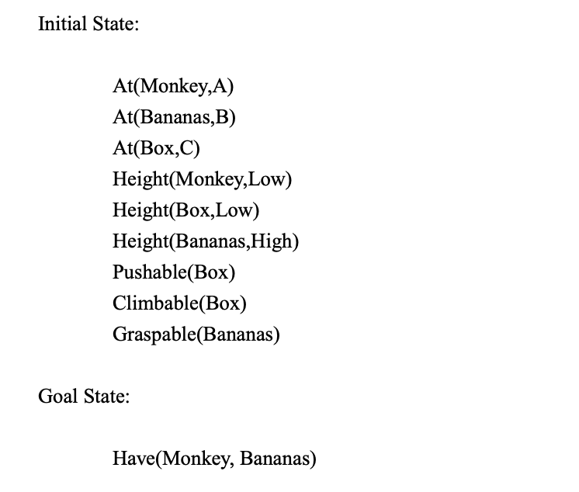
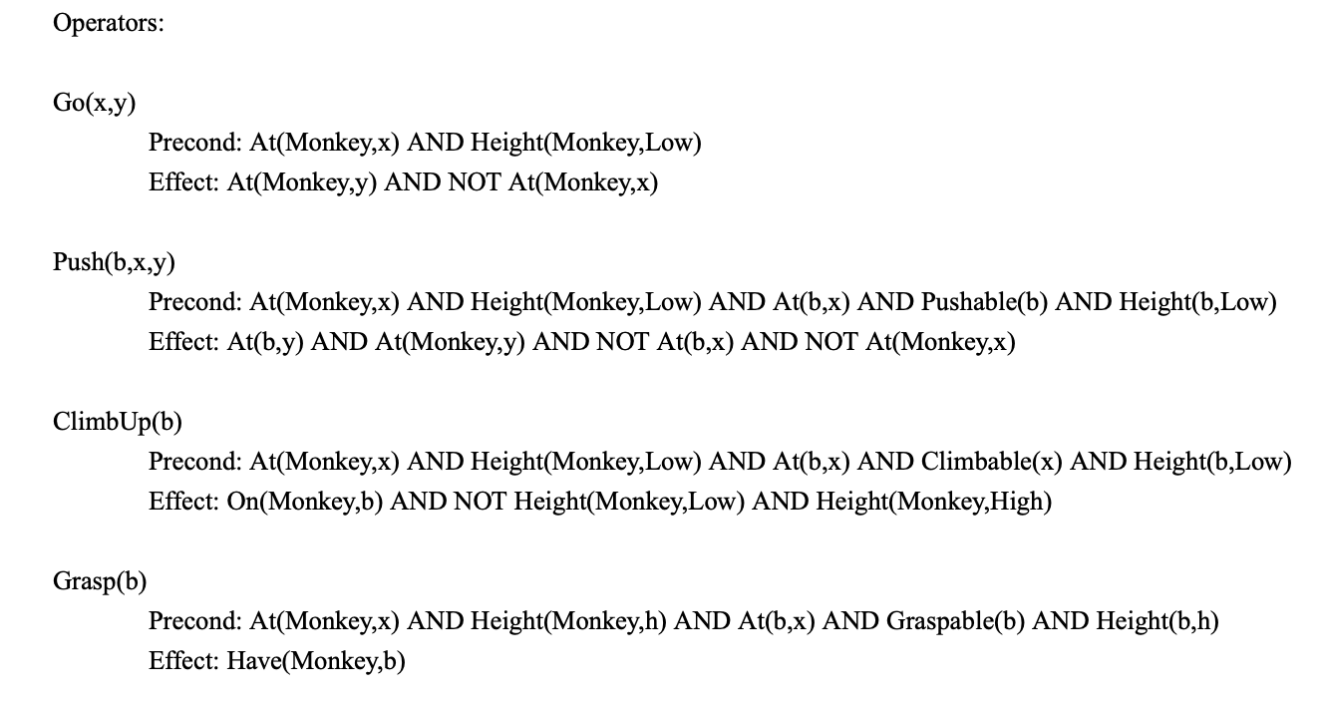
#11.1
Plan: Go(A, C), Push(Box, C, B), ClimbUp(Box), Grasp(Banana)

Slide 8
#11.2
See pages 6-7 of our planning lecture notes.

Slide 9
#11.3
Removing negative effects will not remove any positive states in the world, and thus make the goal easier to achieve.

